Slide 1
Persuasive Argument.
Funding for Drug Treatment Programs

Slide 2
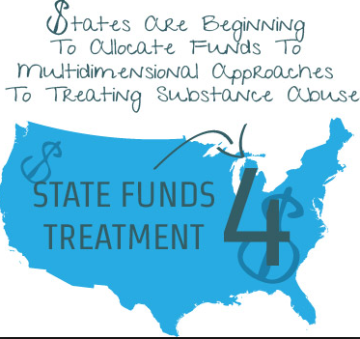
Introduction.
Mental disorder and reliance on drug substances are on the rise in the United States.
Substance addiction has different impacts on peoples’ lives in the United States.
It affects people’s health, family affairs, and community integration (Nathan & Gorman, 2015).
Drug abuse is the leading cause of mental illness according to statistics. It has been quite expensive for Federal and State governments to address drug addictions in the society.
This was attributed to domestic violence, crime, job loss, diseases, and homelessness.

Slide 3
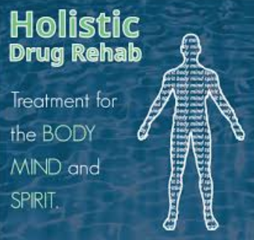
Drug treatment programs in the United States.
The US has been supported by many drug control programs. These include;
Regional prevention training.
Drug-Free Community Coalition Program.
Long-term residential treatment (Lopez, 2017).
Notes:
Regional prevention training helps at equipping the youth with adequate knowledge to withstand and avoid drug abuse practices. Drug-free community coalition Program prioritizes at uniting efforts of different communities to alleviate drug abuse in all community settings (Lopez, 2017). Long-term residential treatment is a residential treatment model with a planned length of stay between 6 and 12 months. It aims at the "resocialization" of the individual and uses the program’s entire community as active components of treatment (Lopez, 2017).

Slide 4

Continuation of types of drug treatment programs in the United States.
Short-term residential treatment.
Outpatient treatment programs (Knopf, 2017).
Individualized drug counseling.
Groups counseling.
Notes:
Short-term residential treatment offers a modified 12 step approach which is originally designed to deal with drugs like alcohol and cocaine among other substance disorders (Knopf, 2017). Outpatient treatment programs are developed to help patients with medical as well as mental health problems associated with substance abuse. Individualized drug counseling aims at reducing as well as stopping unlawful drug use in addition to impaired functioning and the content and patterns of patient recovery programs. This program relies on the 12 step participation. Groups counseling programs rely on group therapy to maximize the social reinforcement given to peers to help encourage drug-free lifestyles.

Slide 5
Goals of drug treatment programs in the USA.
The main goals for drug treatment programs include;
  To reduce drug abuse amid the American populations.
  Delay and possibly alleviate the onset of drug use.
  Minimize the number of deaths related to drug abuse.
  Reduce drug related criminal and violence behaviors.
Notes:
Drug treatment programs are geared towards addressing issues related drug complications. Drug treatment programs aim to reduce drug abuse amid the American populations and hence restoring the wellness of the entire population. They aim at delaying the onset of drug abuse and hence saving young lives. It also aims at alleviating deaths associated with the side effect of drugs such as road accident and sexually transited diseases. Drug treatment program focuses on reducing violence and criminal behaviors attached to substance abuse.

Slide 6

Continuation of Goals of drug treatment programs in the USA.
  Alleviate drug motivated gangs and gang memberships.
  To necessitate self-sustained drug prevention, rehabilitation, education amid the America population.
  Help the addicted on how to manage their condition.
  To preserve the wellness of the present and the future communities.
Notes:
It is widely evident that abuse in the United States is on the rise and that it is the leading cause of drug-motivated gangs and gang membership. Thus, drug treatment programs are geared toward alleviating such cases. Drug treatment program aims at enhancing self-prevention, rehabilitation, and education on the costs of drug abuse. They aim at supporting the addicted individuals on how to manage their tough situations. All these programs give an emphasize that drug is the leading enemy of our future generations, thus, the intent to preserve them by uprooting the associated drug weaknesses.

Slide 7
Key Stakeholders for Drug Treatment Programs.
The core stakeholders in Drug Treatment Programs include;
  The governments
  Parents.
  Non-Governmental organizations (Ed Stevenson, 2016).
  Well-Wishers.
Notes:
The issue of drug abuse has been highly overlooked by many partakers in the United States who often pioneers funding of the drug treatment programs. It is the primary role of the government to address the alarming rate of substance abuse by raising awareness on the effects of drug abuse as well as eh benefits of control. Parents are always concerned about the uprightness of their kids, and hence they offer both financial and material support when dealing with drug addiction (Ed Stevenson, 2016). Non-Governmental organizations are always compassionate to the wellness of the nation, and thus, they are the leading sources of donations to drug treatment programs. Well-wishers pay attention to the current and future wellness of the society.

Slide 8

Forms of Funding for Drug Treatment Programs.
Funding for drug treatment programs takes place in the following forms;
  Budgetary allocations.
  Grants (Knopf, 2017).
  Donations.
  Community funding.
Notes:
Budgetary allocations are the main form of funding drug treatment programs. In this case, the federal government allocates money purposely to run and meet the objectives of drug programs. Grants also play a core role in sourcing capital to support drug treatment programs (Knopf, 2017). Donations are another source of finance which highly supports drug treatment programs. Donations are commonly given by both governments and non-governmental organizations among others.

Slide 9
Conclusion.
Drug abuse is a challenging issue in the United States.
Different programs have been initiated to deal with this pandemic.
Adequate funding is essential for supporting all the attached activities for efficiency (Knopf, 2017).
Failure to provide adequate and consisted funding drug treatment program will subject the US into additional costs

Slide 10
References.
Ed Stevenson (2016). Seeing Drug and Alcohol Addiction in a New Light | Ed Stevenson | TEDxCoeurdalene.[online]Available https://www.youtube.com/watch?v=KYrJ1VV6CWI [Accessed 3 Nov. 2018].
Knopf, A. (2017). Sheriffs, and police tell Trump: More treatment needed. Alcoholism & Drug Abuse Weekly, 29(8), 1-3 https://doi.org/10.1002/adaw.30857.
Lopez, G. (2017). Trump’s budget makes it official: He’s doing little to nothing about the opioid epidemic.Retrievedfromhttps://www.vox.com/policy-and politics/2017/5/23/15680096/trump-budget-opioid-epidemic.
Nathan, P. E., & Gorman, J. M. (Eds.). (2015). A guide to treatments that work. Oxford University Press.

